Slide 1
BIKE STORE Analytics
SQL-Powered Retail Performance System

Slide 2
Overview
01
02
03
04
Load
Schema
Build BI system using SQL Server for a bike retail chain
Load and transform real-world datasets (CSV)
Procedures
KPIs
Develop normalized schema, views, stored procedures, and automation
Provide actionable KPIs for decision-making

Slide 3
Business Scenario
BikeStore: Multi-branch retail chain
Data Collected:
1.Orders, Customers, Products
2.Store Locations, Staff, Inventory
3.Categories, Brands
Business Needs:
1.Automated reports
2.KPIs for leadership decisions

Slide 4
Project Workflow
1. Download Data (.csv files)
2. Ingest & Transform
Clean schema: Keys, constraints
Load CSV (BULK INSERT)
Normalize data (INSERT INTO ... SELECT)
3.Model & Analyze
Create views & stored procedures
4.Automate
SQL Agent job for regular reporting

Slide 5
Data Sources and Modeling
Source
1.products.csv, orders.csv, order_items.csv
2.stores.csv, stocks.csv, staffs.csv
3.customers.csv, brands.csv, categories.csv
Modeling
1Created normalized tables with:
Primary & foreign keys
2.Designed ER Diagram for relationships
3.Ensured scalability and query performance

Slide 6
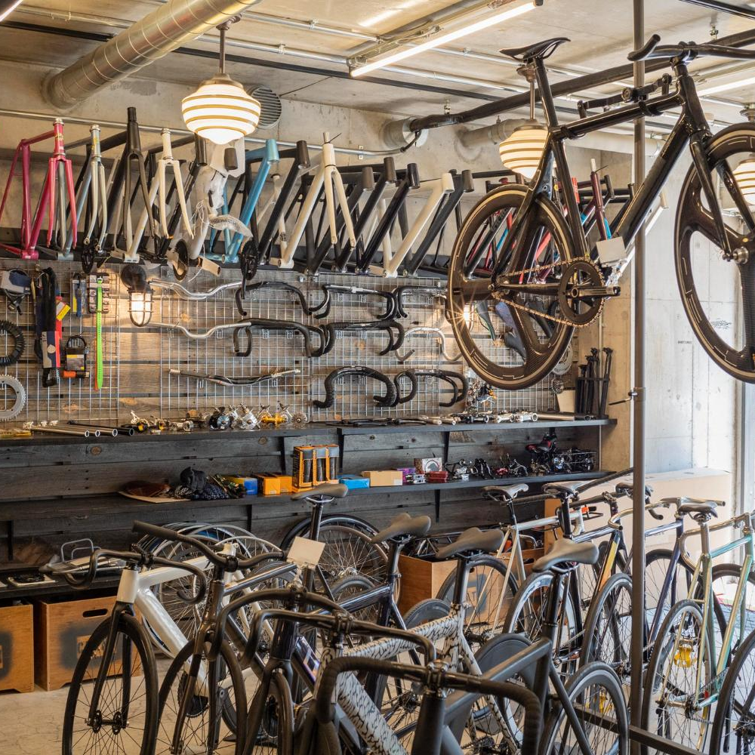
View and Procedure
03

Slide 7
Key Views Created
1. vw_StoreSalesSummary - Store Revenue, Number of Orders, AOV
2. vw_TopSellingProducts - Ranked Products by Sales
3. vw_InventoryStatus - Low Stock Products
4. vw_StaffPerformance - Staff Performance (Orders & Revenue)
5. vw_RegionalTrends - Revenue and Orders by Region
6. vw_SalesByCategory - Sales and Profit by Category
7. vw_CustomerSalesSummary - Customer Sales Summary & AOV
8. vw_store_stock_ratio - Stock vs Sales Ratio by Store
9. vw_MargeBySummary_Stores - Store Sales & Profit Margins
10. vw_MargeBySummary_brands - Brand Sales & Profit Margins
11. vw_staff_summary _sales - Staff Sales & Orders Summary

Slide 8
Key Stored Procedures
sp_CalculateStoreKPI
Store KPIs summary
sp_GenerateRestockList
Restock needs
Procedure
sp_CompareSalesYearOverYear
Yearly sales comparison
sp_GetCustomerProfile
Customer spending analysis

Slide 9
KPIs
04
KPI | Business Insight | Implementation
Total Revenue | Company performance | SELECT sum(Revenue) as Total_Revenue FROM vw_StoreSalesSummary;
Average Order Value (AOV) | Customer spending | SELECT customer_id, first_name, last_name, AOV_customers, Count_orders FROM vw_CustomerSalesSummary ORDER BY AOV_customers DESC;
Inventory Turnover | Stock efficiency | SELECT store_name, stock_ratio FROM vw_store_stock_ratio ORDER BY stock_ratio;
Revenue by Store | Top/weak branches | SELECT store_name, total_sales, CAST((total_sales/SUM(total_sales) OVER())*100 AS DECIMAL(18,2)) AS sales_contribution_pct FROM vw_MargeBySummary_Stores ORDER BY total_sales;
Gross Profit by Category | Margin analysis | SELECT store_name, total_profit, CAST((total_profit/SUM(total_profit) OVER())*100 AS DECIMAL(18,2)) AS profit_contribution_pct FROM vw_MargeBySummary_Stores ORDER BY total_profit;
Sales by Brand | Vendor effectiveness | SELECT * FROM vw_MargeBySummary_brands ORDER BY total_profit DESC;
Staff Revenue Contribution | Productivity | SELECT * FROM vw_staff_summary_sales ORDER BY total_staff_sales DESC, count_orders DESC;

Slide 10
Automation
SQL Agent Job
Daily CSV load
Runs key SPs
Provided configuration documentation & screenshots

Slide 11
Conclusion
Key Achievements
Business Impact
Delivered clean, normalized database schema
Built production-grade reusable reports
Automated workflows with SQL Agent
Provided actionable insights to business users
Faster decision-making with live KPIs
Improved stock management
Enhanced store and staff performance tracking
Better customer understanding

Slide 12
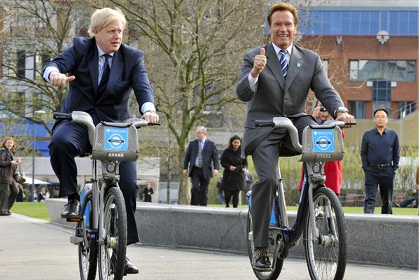
THANKS!

